Slide 1
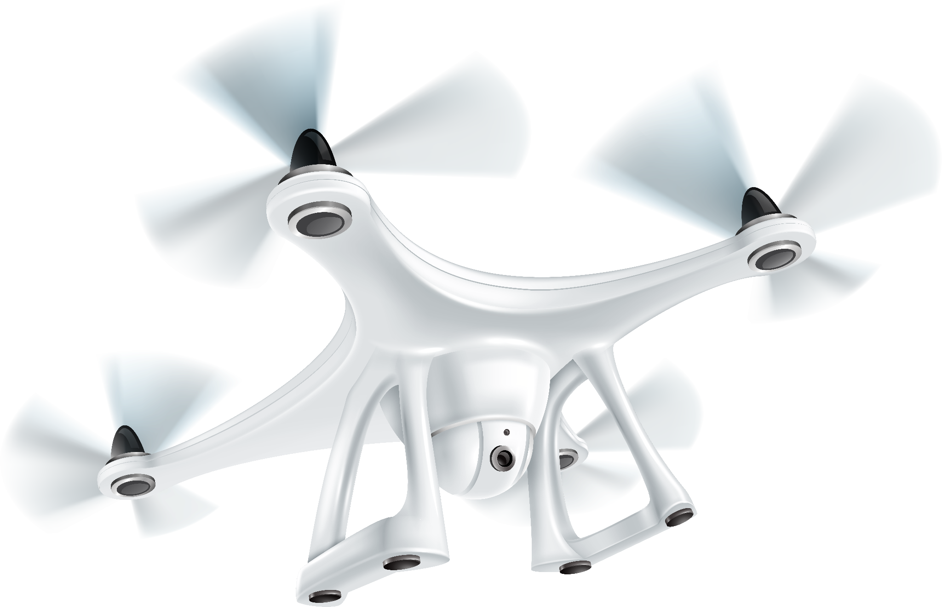
AI-powered drone for plant care in agriculture

Slide 2

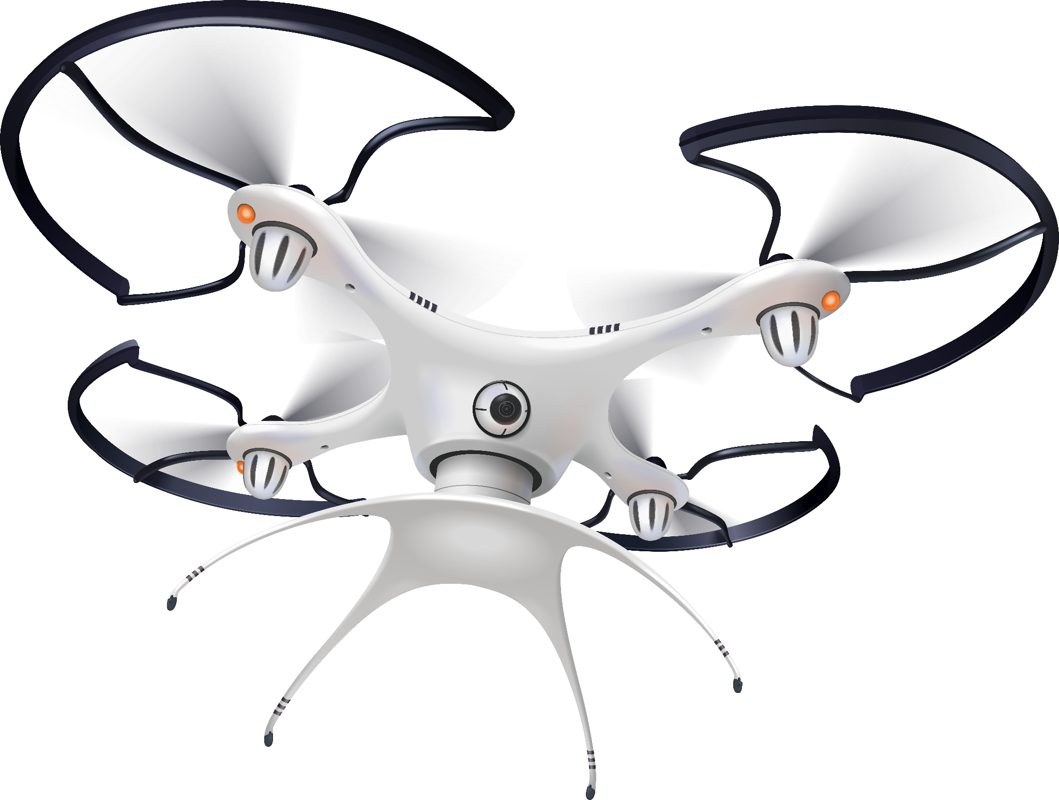
Table of contents
01.
02.
03.
04.
Defining the Project
Estimating Project Times and Costs
Project Plan
Project Budget
05.
Risk Management Plan

Slide 3
Introduction
This project proposal outlines the development of an AI-powered drone for plant care in agriculture. The objective is to leverage advanced technologies to enhance crop health, optimize irrigation practices, detect diseases, and monitor plant growth. By utilizing a combination of AI algorithms, sensors, and cameras, the drone will collect real-time data from crops and provide actionable insights to farmers.
The project scope includes defining the specific objectives, deliverables, milestones, technical requirements, and limitations. The primary goal is to design and build a functional drone prototype capable of autonomously collecting data and analyzing plant health parameters. The project priorities include accuracy in plant health analysis, flight efficiency, and minimizing data latency for prompt decision-making.

Slide 4
Introduction
The work breakdown structure will be created to organize and manage project tasks effectively. By coding the WBS into an information system or project management software, the team will ensure seamless coordination and progress tracking throughout the project lifecycle.
Estimating project times and costs will be crucial to allocate resources efficiently and ensure timely completion. A detailed project plan will be developed, encompassing all activities, timelines, and dependencies. A comprehensive budget will be formulated to cover expenses related to hardware, software development, testing, and personnel.
Risk management will be a priority, and a plan will be devised to identify potential risks and devise appropriate response strategies. Contingency plans, alternative approaches, and risk transfer mechanisms will be considered to mitigate potential challenges.
By successfully executing this project, we aim to contribute to the agricultural sector by providing farmers with an AI-powered drone solution that enables precise and efficient plant care. The integration of advanced technologies will empower farmers to make data-driven decisions, optimize resource allocation, and enhance overall crop yield and quality.

Slide 5

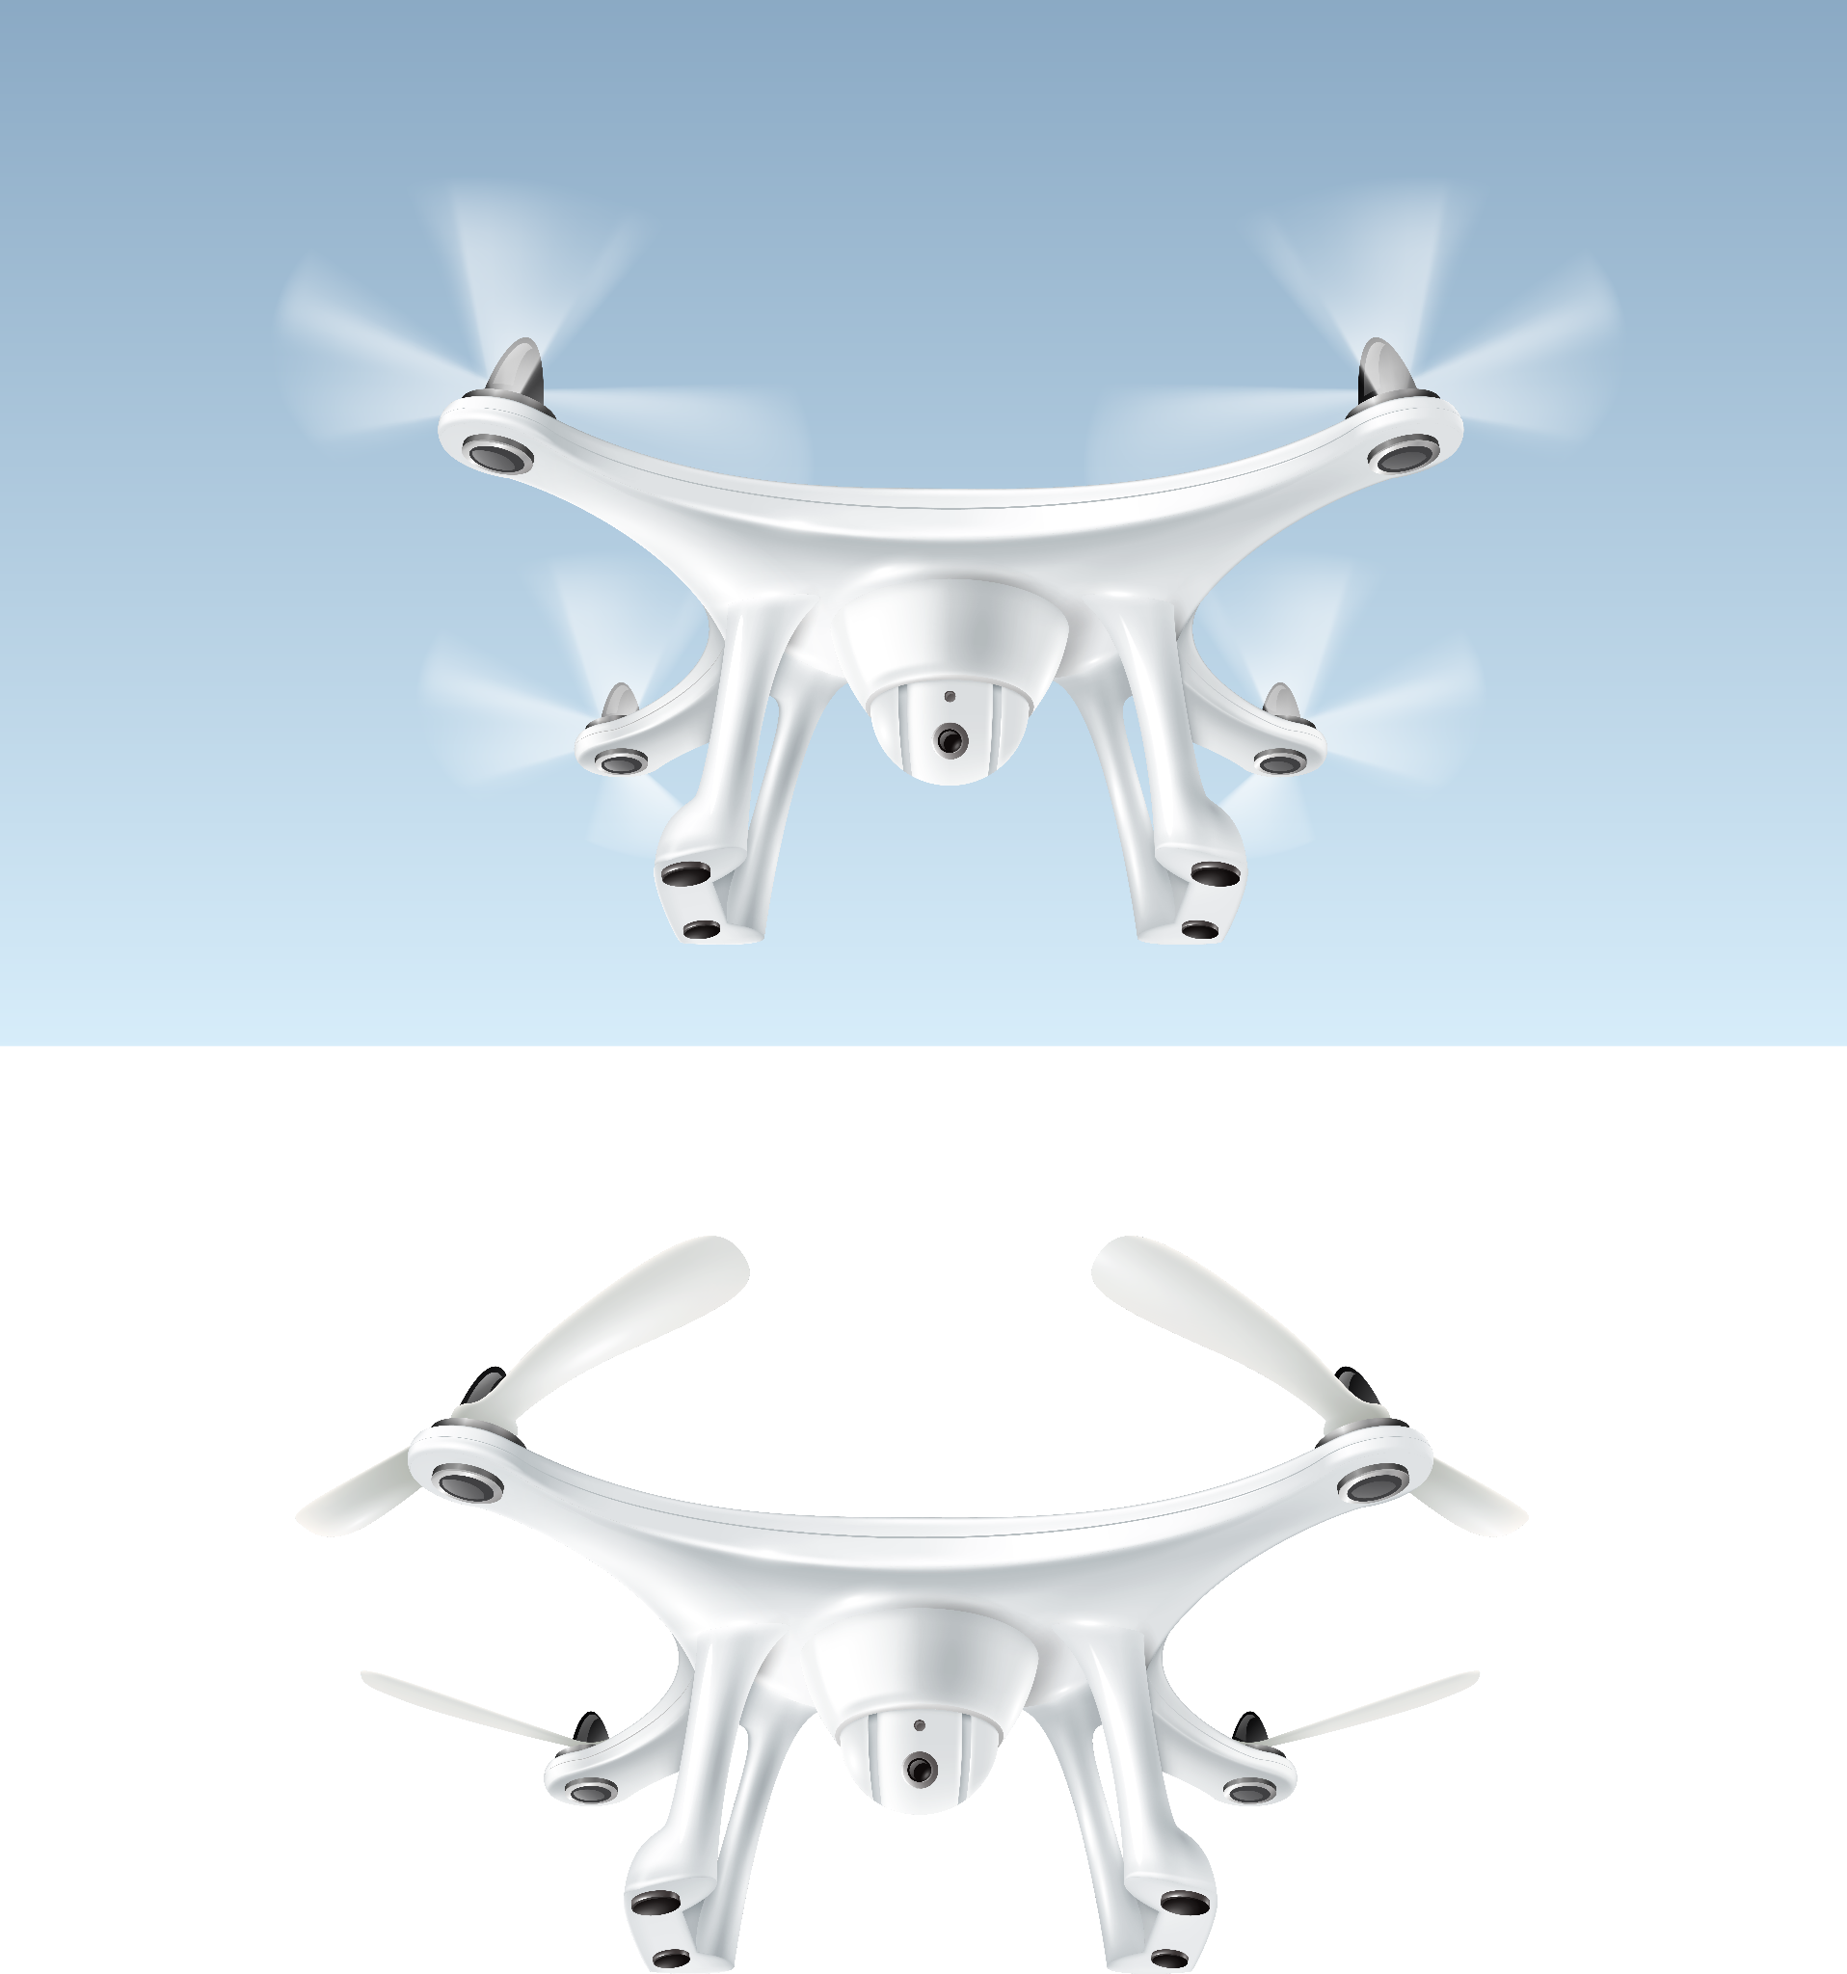
Defining the Project
1.1
1.1 Project Scope:
The project scope outlines the boundaries and focus of the AI-powered drone for plant care in agriculture. It identifies the specific areas and aspects that the project will cover.

Slide 6

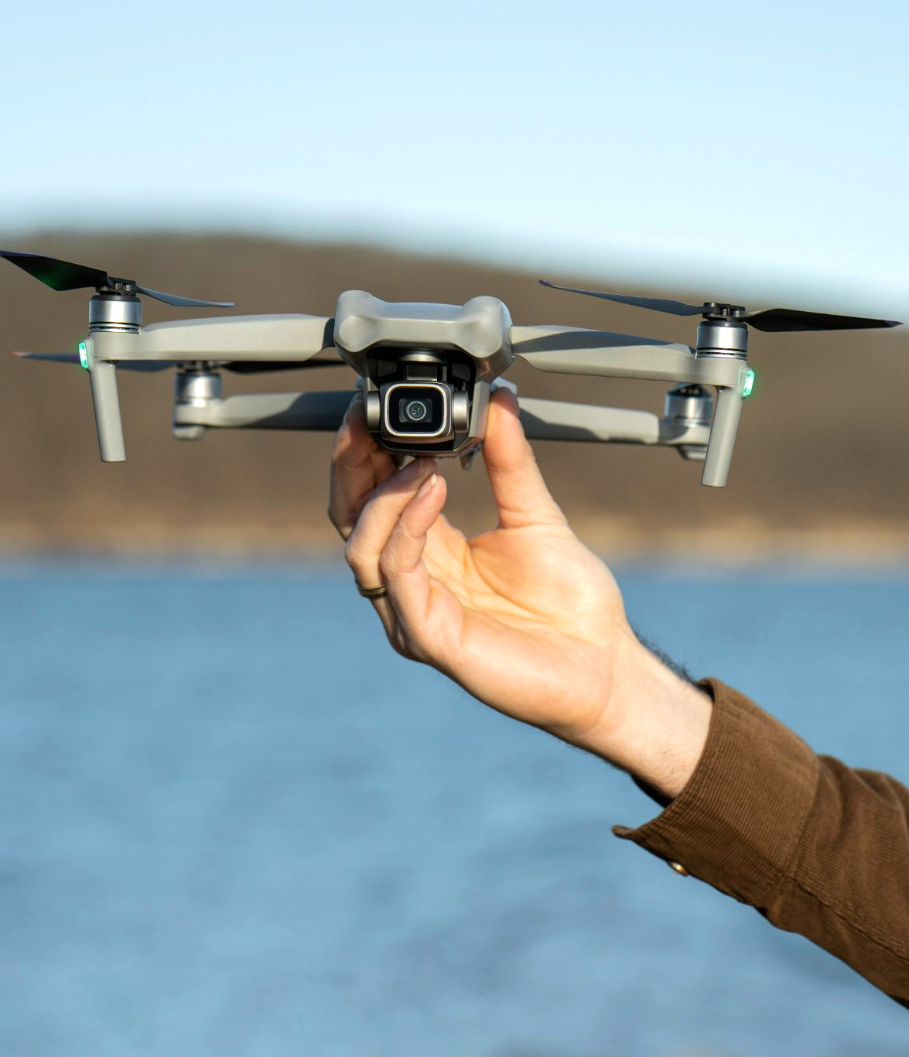
1.1.1 Project Objective
The primary objective of this project is to develop an AI-powered drone system that can autonomously monitor and care for plants in agricultural settings.
The drone will utilize advanced technologies, including artificial intelligence, computer vision, and machine learning, to optimize plant health, detect diseases, and improve overall crop yield. By combining aerial surveillance and data analysis capabilities, the drone will assist farmers in making informed decisions for effective plant care

Slide 7
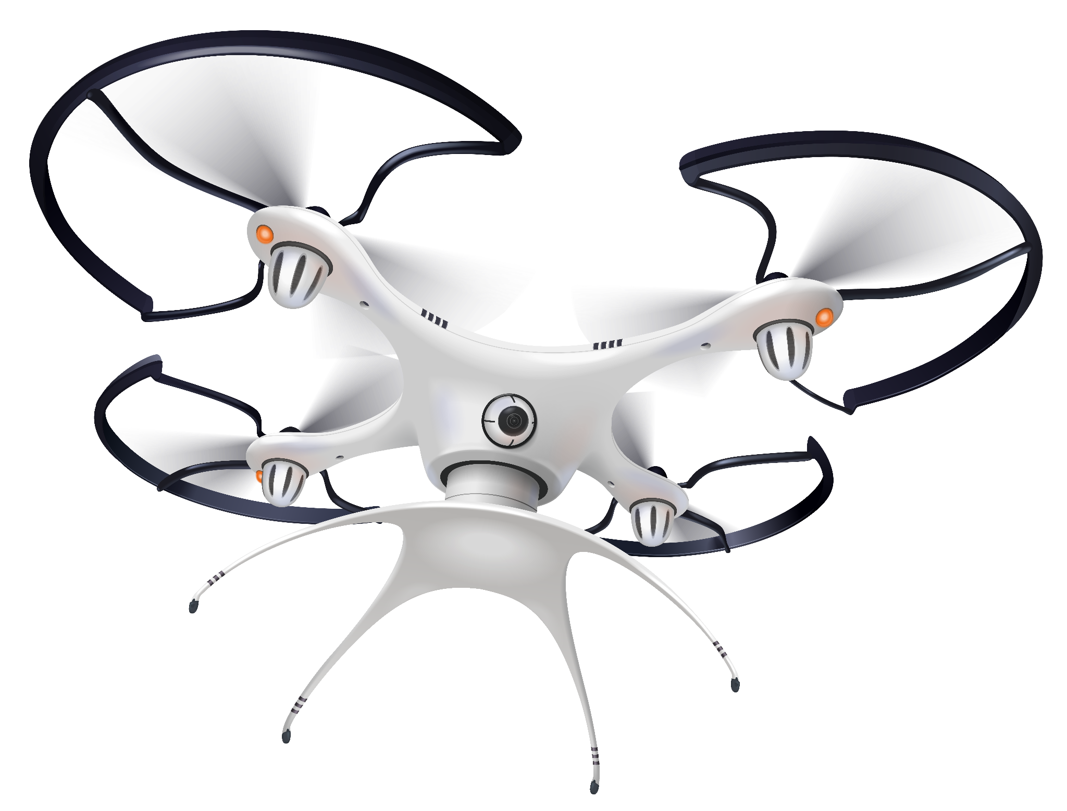
1.1.2 Deliverables
The project will deliver several key outcomes that contribute to the successful implementation of the AI-powered drone system. These deliverables include: ▪ A functional prototype of the AI-powered drone: Development of a fully operational drone capable of autonomously navigating agricultural fields, capturing high-resolution images, and performing plant care tasks.

Slide 8
1.1.2 Deliverables
▪ AI algorithms and machine learning models for plant health analysis and disease detection: Implementation of advanced AI algorithms and machine learning models to analyze collected data, assess plant health parameters, identify diseases or pests, and provide actionable insights.
▪ A user interface for data visualization and interaction with the drone system: Creation of a user-friendly interface that enables farmers to access and interpret data, view analysis results, schedule drone flights, and customize parameters for plant care activities.

Slide 9
1.1.2 Deliverables
▪ Data analytics and reporting: Provision of comprehensive data analytics tools that deliver insights, reports, and recommendations on plant health, disease prevalence, and crop performance.
▪ Integration with existing agricultural systems: Integration of the AI-powered drone system with existing agricultural management systems or software platforms, allowing seamless data sharing and synchronization for enhanced decision-making and workflow optimization.

Slide 10
1.1.3 Milestones
The project will be divided into distinct milestones, each marking a significant progress stage:
Milestone 1: Prototype Development Initiated
➢ Start development of the functional prototype of the AI-powered drone
➢ Begin designing the hardware components and system architecture.
2) Milestone 2: Drone Prototype Completion
➢ Complete the development of the AI-powered drone prototype.
➢ Ensure the drone can navigate autonomously, capture high-resolution images, and perform plant care tasks.
3) Milestone 3: AI Algorithm Development
➢ Develop and implement AI algorithms and machine learning models for plant health analysis and disease detection.
➢ Train and optimize the algorithms using relevant datasets.
4) Milestone 4: User Interface Development
➢ Design and develop a user-friendly interface for data visualization and interaction with the drone system.
➢ Implement features such as data display, analysis results, and customization options.

Slide 11
5) Milestone 5: Data Analytics and Reporting
➢ Develop comprehensive data analytics tools for processing collected data.
➢ Generate insights, reports, and recommendations on plant health, disease prevalence, and crop performance.
6) Milestone 6: Integration with Agricultural Systems
➢ Integrate the AI-powered drone system with existing agricultural management systems or software platforms.
➢ Enable seamless data sharing and synchronization for enhanced decision-making and workflow optimization.
7) Milestone 7: Testing and Refinement
➢ Conduct rigorous testing of the drone prototype, AI algorithms, and user interface.
➢ Iterate and refine the system based on testing feedback and performance evaluation.
8) Milestone 8: Documentation and Training Materials
➢ Create comprehensive documentation, technical reports, user manuals, and training materials.
➢ Provide resources to assist users in understanding and effectively utilizing the AIpowered drone system.

Slide 12
1.1.4 Technical Requirements
The technical requirements for the AI-powered drone system include:
Hardware Components:
➢ Flight control system
➢ Sensors (GPS, cameras, multispectral sensors, environmental sensors)
➢ Communication systems
2) AI and Machine Learning Capabilities: ➢ High-performance processors
➢ Memory and storage
➢ Training and optimization capabilities

Slide 13
1.1.4 Technical Requirements
The technical requirements for the AI-powered drone system include:
3) Navigation and Plant Care Capabilities:
➢ Autonomous navigation
➢ Plant care tools
➢ Precision and accuracy
4) Data Processing and Analysis:
➢ Data storage and management
➢ Real-time processing
➢ AI algorithms and models
5) User Interface and Integration:
➢ User-friendly interface
➢ Integration with agricultural systems

Slide 14
1.1.5 Limits and Exclusions
1) Operational Limits:
3) System Limitations:
• Weather conditions, flight range, and payload capacity have operational constraints.
• Battery life, processing capabilities, and data storage have inherent limitations
5) Importation Limitations Due to Occupation:
2) Legal and Regulatory Compliance:
4) Exclusions:
• The occupation may impose constraints on importing the required equipment, including drones and hardware components
• Compliance with drone regulations and obtaining necessary permits and licenses.
• Certain physical plant care actions and crop-specific limitations may be excluded.

Slide 15
1.2 Project Priorities
▪ Technology Development: Focus on integrating advanced technologies like AI and machine learning for enhanced drone capabilities in plant care.
▪ Accuracy and Efficiency: Emphasize precise and efficient data collection, analysis, and plant care activities.
▪ User-Friendly Interface: Develop an intuitive interface for easy interaction, data access, and actionable insights for farmers.
▪ Cost-Effectiveness: Strive for budget-friendly solutions without compromising functionality and performance.
▪ Safety and Compliance: Prioritize safety measures and compliance with drone regulations in agriculture.

Slide 16
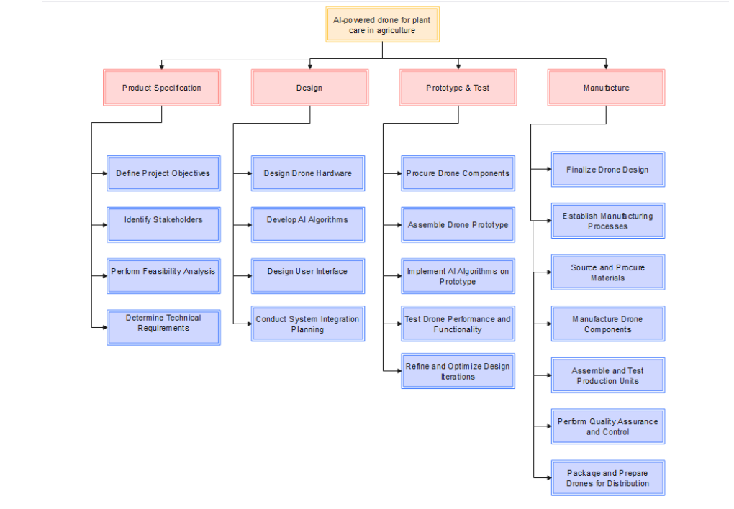
1.3 Work Breakdown Structure
Each phase consists of several tasks that need to be accomplished for successful completion. A detailed WBS will further breakdown these tasks and assign responsibilities.

Slide 17
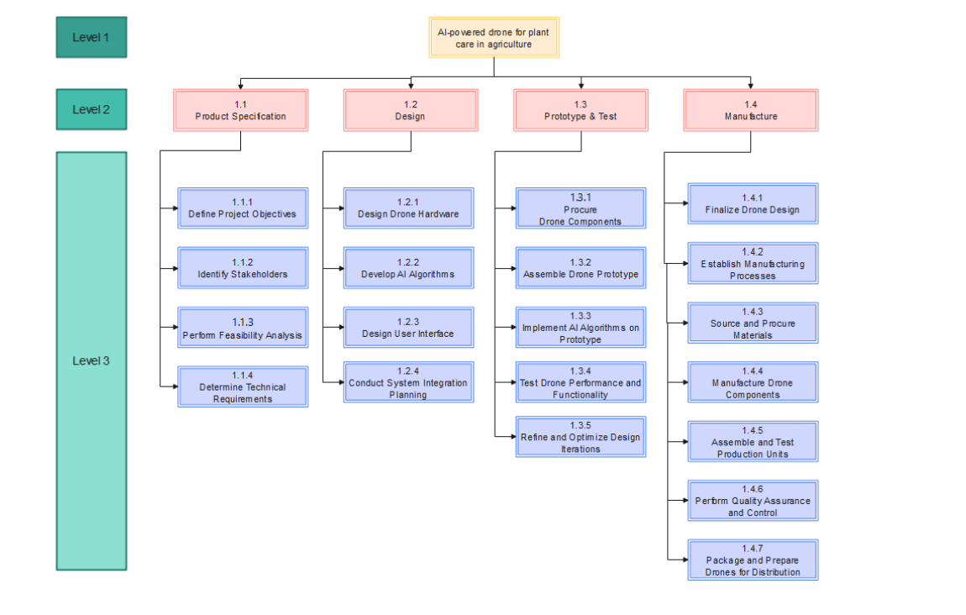
1.4 Coding the WBS for the Information System
A unique identifier or code will be assigned to each component of the WBS to enhance project management efficiency. The coding system will facilitate easy tracking, coordination of project tasks, and provide an efficient means of organizing project information.

Slide 18
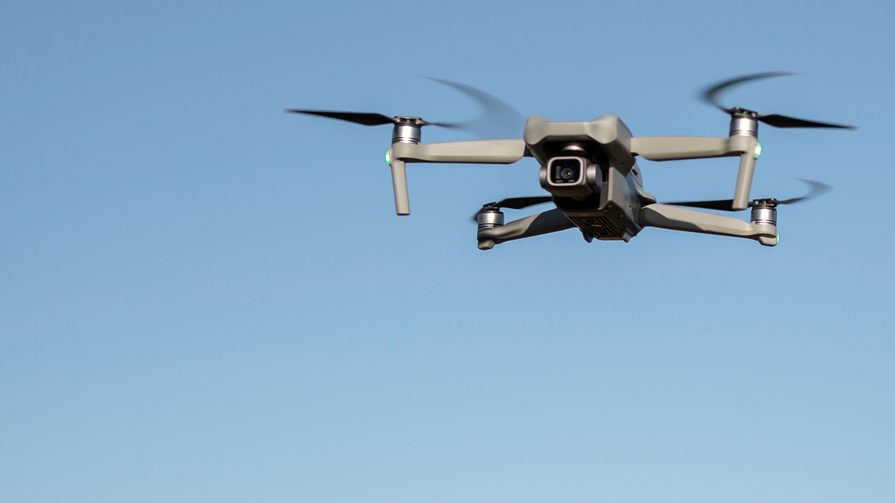
Estimating Project Times and Costs
The project is expected to span a duration of approximately 6-8 months, taking into account all stages from the initial product specification to the final manufacturing phase and post implementation review. The estimated costs for the project are set at $100,000, with a breakdown of costs across different activities. This accounts for cost components including drone technology, specialized sensors, system development, labor costs, and testing procedures.
2.1

Slide 19
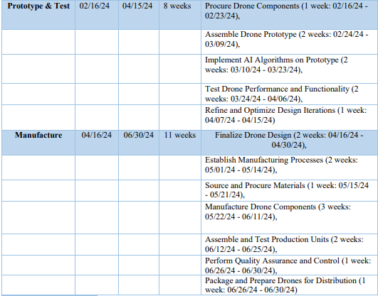
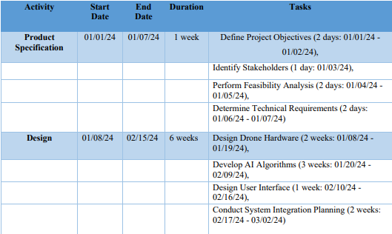
1) Estimated Times:

Slide 20
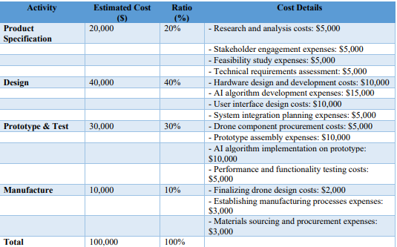
2) Estimated Costs:

Slide 21
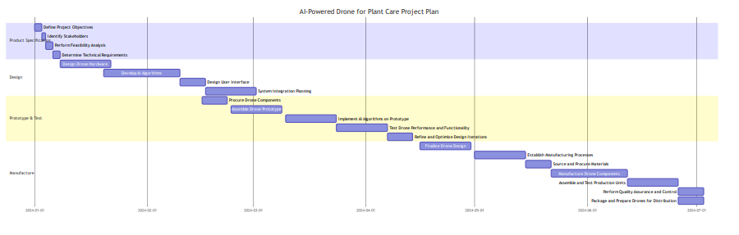
Project Plan
The project is set to commence on January 1, 2024, and is expected to be completed by June 30, 2024. The project is divided into four main phases: Product Specification, Design, Prototype & Test, and Manufacture.
3.1
This project plan provides a structured approach to developing the AI-powered drone for plant care, ensuring that all necessary steps are taken to deliver a high-quality, effective product.

Slide 22
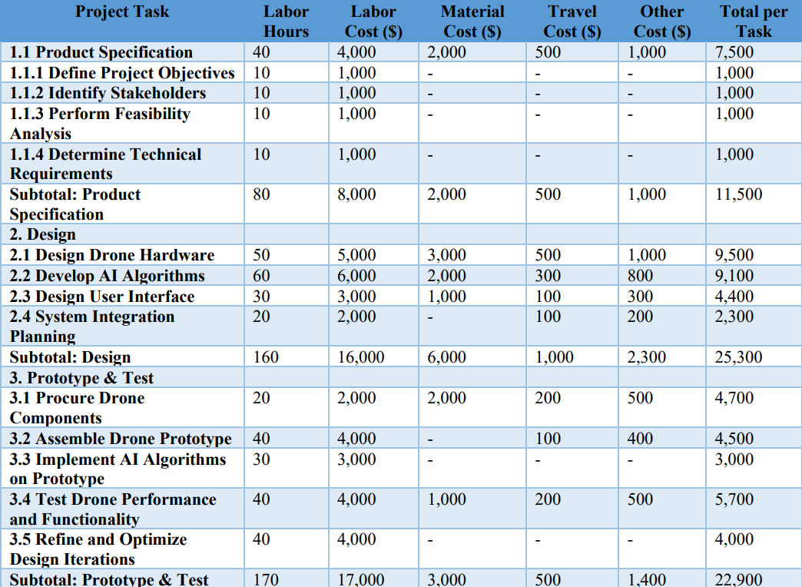
Project Budget
The project budget will be meticulously divided into various categories, including feasibility study, system design and development, labor, testing, and implementation. A significant portion of the budget is anticipated to be allocated to system development and testing, considering the technical complexities involved.
4.1

Slide 23
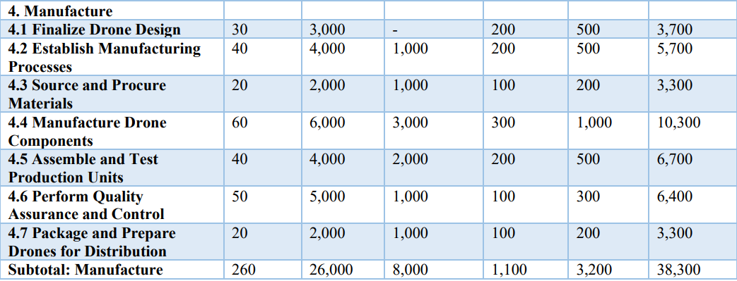
Project Budget

Slide 24
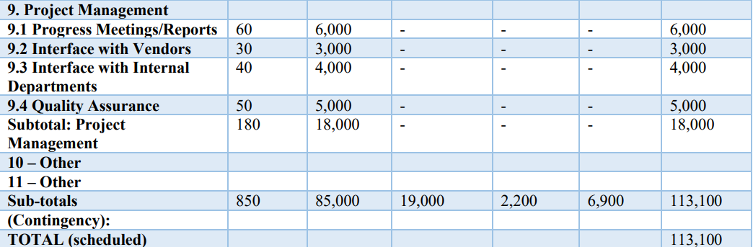
Project Budget

Slide 25
Risk Management Plan
The project will follow a systematic risk management approach, outlining potential risks such as technical challenges, cost overruns, timeline delays, and unmet plant care requirements. This risk management plan will guide the project team in identifying, assessing, and responding appropriately to these risks throughout the project lifecycle.
Risk Management Plan
Internal Factors
External Factors
Technical Factors:
Mercury is the closest planet to the Sun and the smallest one
Despite being red, Mars is actually a cold place. It’s full of iron oxide dust
Venus has a beautiful name and is the second planet from the Sun
5.1

Slide 26
Internal Factors:
• Inadequate resources: Insufficient budget, limited workforce, and lack of equipment (H).
• Lack of expertise or skills: Team members lacking necessary technical knowledge or specific skills (M).
• Poor communication or collaboration: Miscommunication, lack of coordination, and ineffective collaboration among team members (M).

Slide 27
External Factors:
• Changes in market conditions: Shifts in customer preferences, emergence of new competitors, and changes in market demand (H).
• Economic fluctuations: Economic recessions, inflation, and currency exchange rate fluctuations (M)
. • Regulatory changes: new regulations, compliance requirements, and legal restrictions impacting the project (M).

Slide 28
Technical Factors:
Technology failures: Hardware or software malfunctions, system crashes, and compatibility issues (M)
. • Software bugs: Programming errors, software glitches, and unexpected software behavior (M).
• Scalability limitations: Inability of the system to handle increased workload or user demand without performance degradation (L).

Slide 29
5.1 Risk Response Strategies
Risk response strategies are crucial for mitigating and managing risks in a project. They involve the utilization of various techniques and tools to identify and assess risks effectively.
Three key elements that aid in implementing risk response strategies are the Risk Identification Team, Risk Breakdown Structure (RBS) Template, and Risk Identification Methods

Slide 30
5.1 Risk Response Strategies
Risk Identification Team:
To ensure comprehensive risk identification in the AI-powered drone project, it is essential to establish a dedicated Risk Identification Team. This team consists of experts from various disciplines, including drone technology, AI algorithms, project management, and relevant stakeholders
2) Risk Breakdown Structure (RBS) Using Risk Identification Methods:
The Risk Breakdown Structure (RBS) is a valuable tool for organizing and categorizing risks in the AI-powered drone project. By utilizing various risk identification methods, risks can be identified and incorporated into the RBS. These methods include:
• Brainstorming Sessions: Conduct brainstorming sessions involving the project team, stakeholders, and subject matter experts to generate ideas and identify potential risks.
• Expert Judgment: Seek input from domain experts in drone technology, AI algorithms, and project management to leverage their knowledge and experience in identifying risks.

Slide 31
5.1 Risk Response Strategies
3) Risk mitigation plan:
✓ Risk: Technical challenges in AI algorithm development. Mitigation Plan: Allocate additional resources for research and development, conduct rigorous testing and validation, and engage subject matter experts to address technical complexities.
✓ Risk: Supply chain disruptions leading to delays in procuring drone components. Mitigation Plan: Identify alternative suppliers, maintain buffer inventory, establish clear communication channels with suppliers, and implement supply chain risk management strategies.
✓ Risk: Regulatory changes impacting drone operations. Mitigation Plan: Stay updated with regulatory requirements, maintain close collaboration with regulatory bodies, and adapt the drone design and operations to ensure compliance with changing regulations.
✓ Customer Changes - Maintain a flexible project scope and change management process to accommodate customer changes while ensuring that they are properly assessed for their impact on the project timeline, budget, and resources

Slide 32
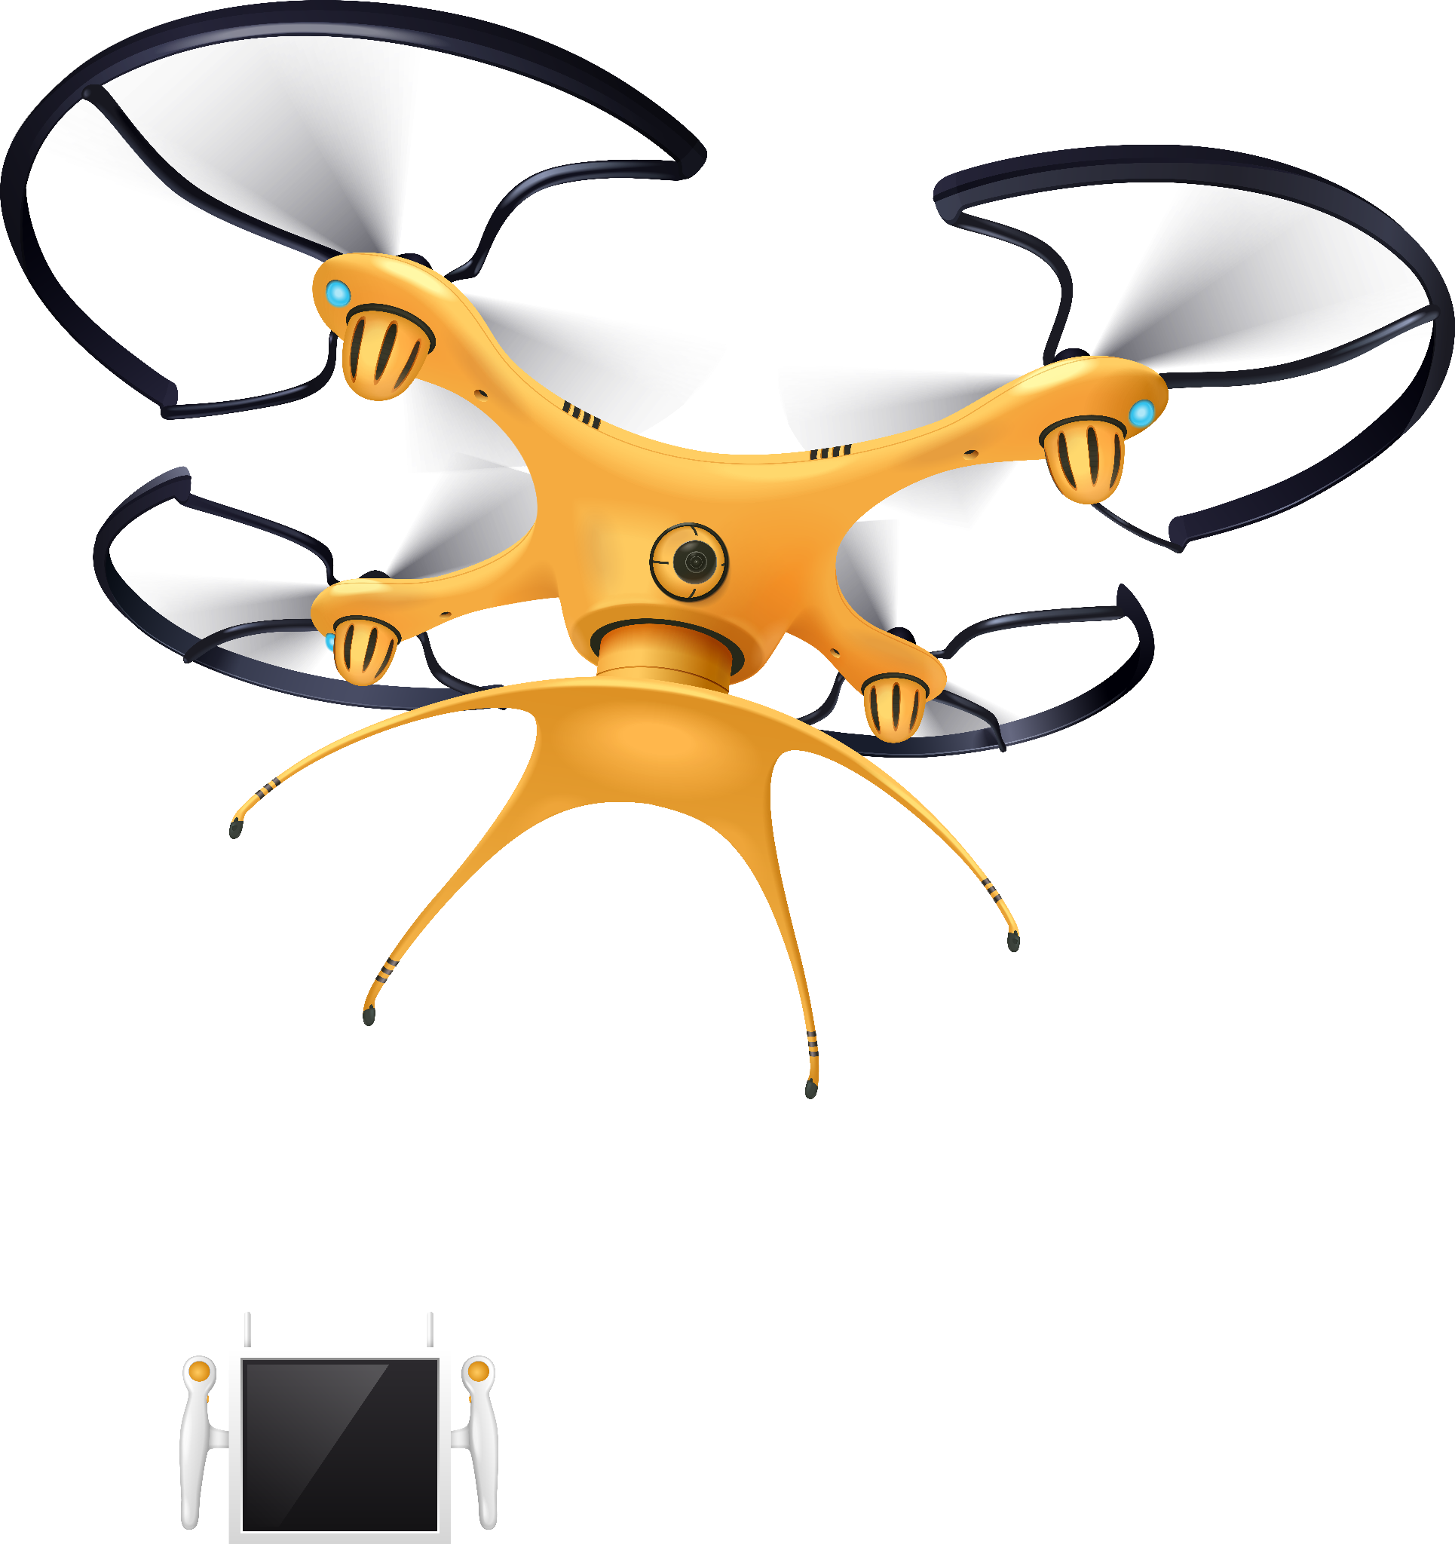
Thanks

